Slide 1
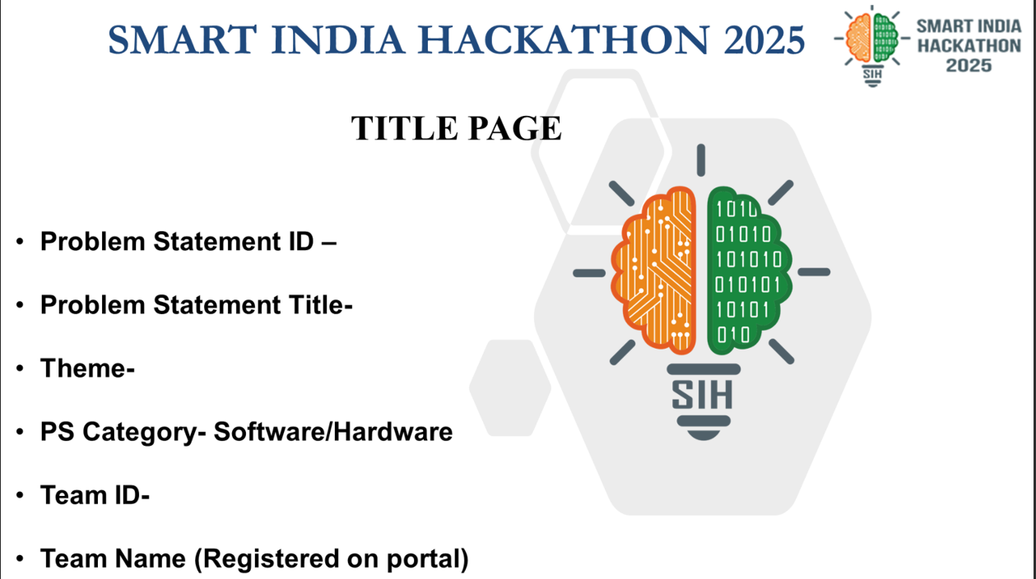
25010
Smart Crop Advisory System for Small and Marginal Farmers
Agriculture, FoodTech & Rural Development
Software

Slide 2


1.Introduction
Aligned with SIH goals: Inclusive tech, scalable architecture, sustainable agriculture
Small & marginal farmers = 86% of India’s farming community, produces only 50% of output
2. Problem Statement
Key challenges:
Limited access to accurate crop advisory
Vulnerability to climate risks
Poor access to market data & financial service
Knowledge Gaps: Reliance on tradition/local dealers; lack of timely, scientific advice
Low Yields, High Costs: Poor crop/pest guidance → 83% overuse fertilizers
Climate & Market Risk: 80% hit by erratic weather; 75% lack fair market access
Digital Divide: 70% low literacy; prefer local languages
Survey Stats:
76.3% → Financial stress
75.6% → Market issues
51.1% → Lack of training
Only 12.5% saw income > costs
Digital divide persistsdue to:
Low literacy rates
Language diversity
Lack of localized, user-friendly tools
Our solution: A multilingual, AI-powered mobile app & chat bot that:
Provides real-time, location-specific farm advisory
Supports crop selection, soil health, pest/disease detection, fertilizer guidance
Offers voice support for low-literate users
Aligned with SIH goals: Inclusive tech, scalable architecture, sustainable agriculture

Slide 3
4. Proposed Solution: Multilingual AI-Powered Mobile App/Chatbot
3. Impact of Limited Advisory: Yield, Costs, and Environment
A unified, AI-powered mobile platform designed to provide real-time, personalized agricultural advisory to small and marginal farmers by integrating multiple features into a single app or voice-chatbot.
Yield Losses: Without science-based crop planning or timely pest alerts, yield losses can reach up to 30% annually. For example, crop diseases alone are responsible for 20–40% loss annually in India.
Key attributes: Multilingual (Indian languages), text and voice support, smartphone and basic phone accessible, scalable API integration.
High Input Expenditures: Overuse or incorrect use of fertilizers/pesticides is common due to lack of soil data—83.6% of surveyed Indian farmers use synthetic fertilizers, often inefficiently.
Key Functional Modules
Market Prices and Notifications: Synchronization with Agmarknet and eNAM for daily Mandi/market rates; price-trend alerts and location-wise insights.
Environmental Degradation: Blind fertilizer usage increases soil and water contamination, while limited irrigation advisory leads to wastage of precious water resources. Flood irrigation (used by 62.5% of smallholders) is linked to soil erosion and salinity issues.
Weather Alerts and Climate Risk: Real-time, hyperlocal weather forecasting and push notifications for impending events such as rain, frost, or heatwaves—fed by IMD/APIs and in-field IoT sensors
Market/Price Exploitation: Poor access to market rates forces distress sales; ~75% report market difficulties and low price realization. Many must sell to local intermediaries at prices 15–20% below market value.
Pest and Disease Detection: Image-based diagnosis via smartphone camera, chatbot upload, or WhatsApp, returning AI-driven analysis with recommended interventions (organic and chemical).
Location-specific Crop Advisory: AI recommendations on which crops to sow, considering soil type, previous crops, market demand, weather, and available resources.
Case Studies/Impact Papers:
Voice Support for Low-Literate Farmers: Chatbot listens and responds in regional languages (Hindi, Punjabi, Bengali, Marathi, etc.) using advanced speech recognition and text-to-speech synthesis.
Ama Krushi-Large-Scale Digital Advisory Impact
IAMAI 2025: Al in Agriculture-Impact and Market Trends

Slide 4
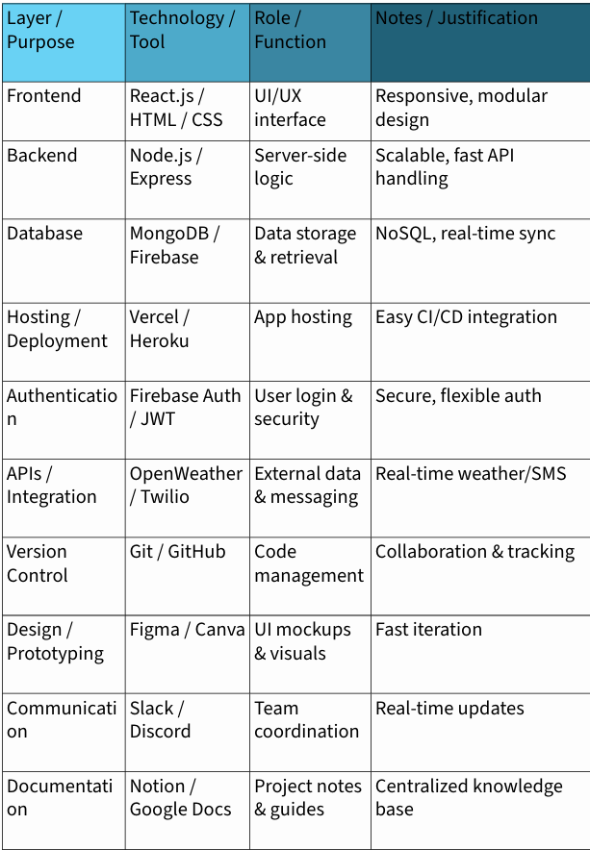
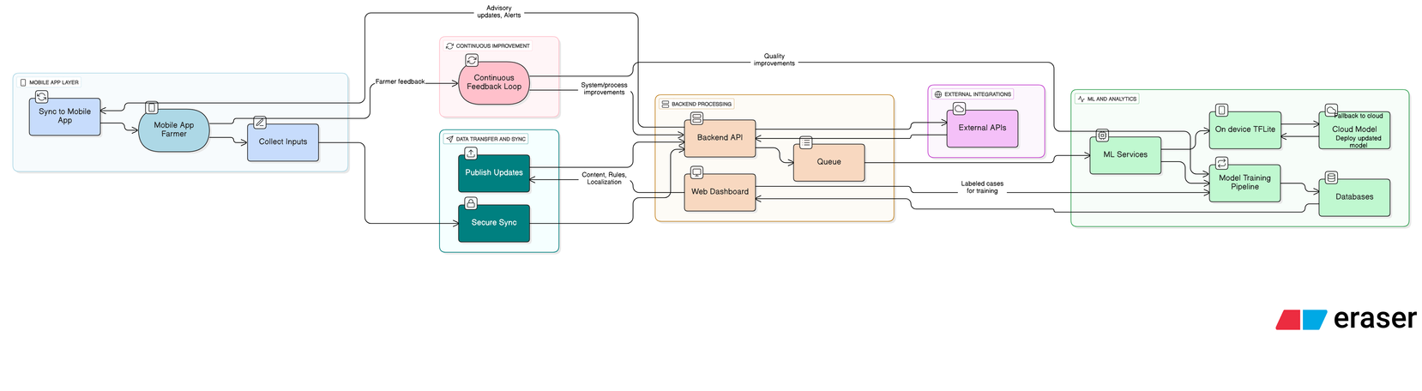
5. Methodology & Build Approach
6.Technology Stack and Key Tools
Frontend: Android/iOS app (Flutter/React Native), chatbot web version, WhatsApp & IVR support.
Multilingual NLP: AI models (Llama 3, GPT-4, etc.) fine-tuned on agri-domain data; supports 8+ languages
Voice Support: STT/TTS via Google Cloud APIs + offline fallback
Backend: FastAPI/Flask microservices integrating:
Soil health APIs
IMD weather data
Agmarknet mandi prices
AI models for pest/disease detection
AI/ML Models:
Crop advisory: Random Forests/SVM
Pest scan: CNNs/YOLO (PlantVillage, ICAR)
Weather alerts: LSTM/RNN
Federated learning for privacy
End-to-end system data flow
Personalization: Farmer profile includes crop history, soil data, language, and usage patterns.
Security: AES-256 encryption; GPS/income data stays on-device; strict consent model.
Continuous Learning: Real-time model tuning via federated Q&A/image feedback.
Accessible & Inclusive: Visual/audio UI, offline caching, gender-sensitive & low-literacy design.
Scalable: Modular APIs for fast rollout, FPO/FPC integration, easy feature expansion.
References/Resources:
AgriVoice Voice & Text Assistant
Agri Bot with LangChain
GitHub - Project Kisan: Open Source Al Agri Assistant
Soil Nutrient Sensing Device at IIT Kanpur

Slide 5
7. System Functionality: User Journey and Modules
Advisory Interaction: Multilingual chat/voice/image input; AI gives read-aloud or text response.
Voice Support: Full audio guidance for non-literate users.
Stepwise Experience:
Login & Onboarding: Mobile-based, via OTP, WhatsApp, or FPO/FPC support.
Profile Setup: Guided entry of farm size, crops, soil test (manual/photo/QR), voice sample for language.
Smart Alerts: Push notifications for irrigation, weather, pests, market dips
Offline Mode: Caches key info; syncs when online
Feedback Loop: Farmer rates advice; chatbot adapts.
Use Cases:
Home Screen Modules:
Ask Crop Doctor (chat/image)
My Soil Health
Weather Alerts
Market Prices
Govt Schemes
Crop Planning:
Disease Diagnosis:
Market Strategy:
Extension Updates: Voice alerts on PMFBY deadlines & SHC subsidies.
References/Resources:
Smart India Hackathon 2025 Official Portal
ICRISAT ISAT Advisory Tool Case
Agri Bot: Al Chatbot for Farmers
CropSathi Smart Agriculture Platform

Slide 6
Impact & Feasibility
Yield & Productivity: +20–30% yield through data-driven cropping & timely inputs
Loss Reduction: Early pest/disease detection cuts losses 10–25%, lowers input cost 20%
Resource Efficiency: Fertilizer waste ↓ 30%, water saved 15–40% with precision irrigation
Farmer Income: Seasonal earnings ↑ 4–6% via better market timing & direct buyer linkages
Inclusion: Voice + local language → empowers women, elderly, low-literate farmers
Key Benefits of the Solution
For Farmers
Yield ↑ 20–30% through data-driven cropping
Input cost ↓ 20–30% (fertilizer, water, pesticides)
Income ↑ 4–6% via better market timing & direct linkages
Reduced risk from early weather & pest alerts
Inclusive access with voice + local language support
For Society & Environment
Food security boost through higher productivity
Sustainable farming: less chemical overuse, lower GHG emissions
Water conservation: 15–40% savings via precision irrigation
Soil health protection through optimized fertilizer use
Proven Tech: AI/ML models already validated in agri-advisory pilots (CropIn, Plantix, Ama Krushi)
Data Backbone: Integration with KVK, ICAR, ICRISAT, weather APIs, eNAM ensures reliability
Farmer-Centric Design: Offline caching, voice-first UX, low-bandwidth optimization
Scalable Model: Modular architecture, easy to replicate across states & crops
Adoption Drivers: Govt schemes, NGO partnerships, FPO/FPC networks accelerate trust & uptake

